Slide 1


Collaborative Filtering Model for Matching User with Similar Music Taste
Rashi Gupta
IT – A (2)
11913039
Anshika Jain
IT – A (2)
11913034
Varsha Sahu
IT – B (4)
11913061
Notes:
Add diagrams if possible
Challenges faced

Slide 2
Motivation / Novelty
Microsoft enables digital transformation for the era of an intelligent cloud and an intelligent edge.
Its mission is to empower every person and every organization on the planet to achieve more.
Microsoft set up its India operations in 1990.
Microsoft in India offers its global cloud services from local data centers to accelerate digital transformation across Indian start-ups, businesses, and government agencies.

Slide 3
Why collaborative filtering is used
Identify stale branches and clean them up
1
Notify the PR author the build number where changes will be available.
2
Warn the developer when he tries to make changes involving use of HTTP urls
3
On every build complete, notify the team on what changes went in
4

Slide 4
1. Cleaning Stale Branches
Motivation and Impact
Hundreds of branches in repos
Only some of them are significant
Older branches are either merged or no longer important
Improve maintenance of large project

Slide 5


Technology used
Git
PowerShell Scripting

Slide 6
Proposed Algorithm
Fetch the list of branches
Iterate through each branch; extract author and last update date
Delete branch if it is last updated before say 2 years
Also, hashed the branches with key as author mail

Slide 7
2. Comment Build No on PR Complete
Motivation and Impact
Notify author the next incremental build number in which the fix/changes will be reflected.
Post a comment on PR when user merges or completes it
The user can directly refer that build to see the changes

Slide 8


Technology used
Service Bus Queue
Queue Trigger Azure Function

Slide 9
Approach Used
Added a Service hook that listened for the event ‘PR complete’.
The Service hook post a message (JSON data) to an Azure Service Bus Queue.
Created a queue trigger azure function that listens to the queue
The function calculates the next build no and post a comment on the PR

Slide 10
3. Warn User for HTTP Based Urls
Motivation and Impact
HTTP links are not secure, and their usage should be avoided.
Identify use of HTTP links in the changes made by the user.
Warn the developer and confirm before committing the changes.

Slide 11


Technology used
Githooks
Shell Scripting

Slide 12
Approach used
Created a pre-commit Githook
From the list of changes extract positive changes including ‘http:’
If any such change is found warn the user that use of such changes can be insecure.
Confirm from user if he still wants to commit and continue accordingly

Slide 13
4. Email Build Changes to the Team
Motivation and Impact
Whenever a build completes send email to the team.
The mail will contain list of changes (commits) that went into the build

Slide 14
Technology used
HTTP trigger Azure function

Slide 15
Approach used
Using an API call fetch the latest build details in the pipeline
Extract Id of the latest build.
Made another api call to fetch all the changes for the build id.
Converted the json data into html table
Repeated the steps for 6 official ConfigMgr pipelines
Collated all the data and send email to the team

Slide 16
Learnings
Powershell Scripting
Queue Trigger Azure Functions
Service Hooks
Azure Service Bus Queue
C#, .NET
XML and JSON Data Parsing
Githooks
Posting Comment on PR
HTTP Trigger Azure Fucntion

Slide 17
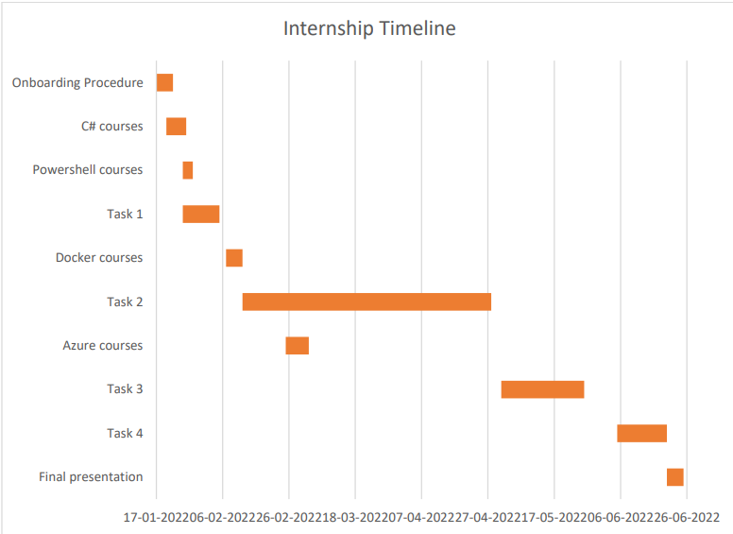

Slide 18

Any questions/feedback?

Slide 19
Thank You!!

